Slide 1
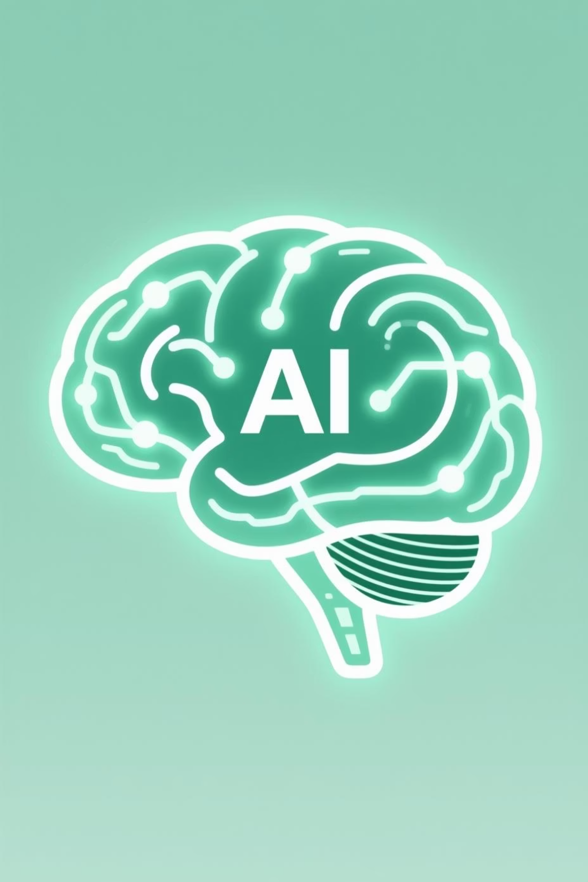
Vector Databases: The Backbone of AI
AI is transforming our digital horizon, and vector databases are the crucial, often overlooked, technology making this AI reality possible. Recent research highlights their inevitability in AI, especially for large language models.

Slide 2

What is a Vector Database?
Unlike conventional relational databases, vector databases excel at storing and retrieving unstructured data (images, text, audio, video) based on meaning, not just keywords.
They house data as high-dimensional vectors, mathematical models that grasp semantic value. Convergent data points in this space are analogous, allowing for meaning-based searches.

Slide 3




Game-Changing Benefits
Semantic Search
Unstructured Data Management
Retrieves information based on similarity, enabling advanced NLP, computer vision, and recommendation systems.
Processes complex data types like text, image, audio, and video more effectively than relational databases.
Scalability & Real-time Processing
Distributes workload across machines using sharding, partitioning, caching, and replication to avoid bottlenecks.

Slide 4
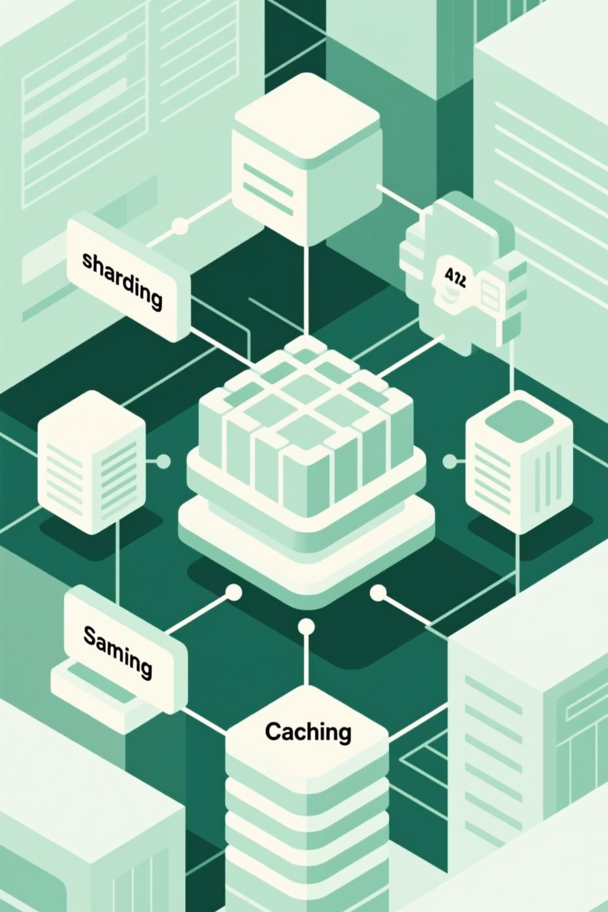
The Storage Layer: Handling Huge Vectors
Effective data management is crucial for vector database performance. Key storage primitives include:
1
Sharding
Splits data across different servers (range-based, hash-based, geographic).
2
Partitioning
Organizes data within nodes (range, list, k-means, hash).
3
Caching
Speeds up data access (FIFO, LRU, MRU, LFU, partitioned).
4
Replication
Ensures availability and fault tolerance (leader-follower, multi-leader, leaderless).

Slide 5
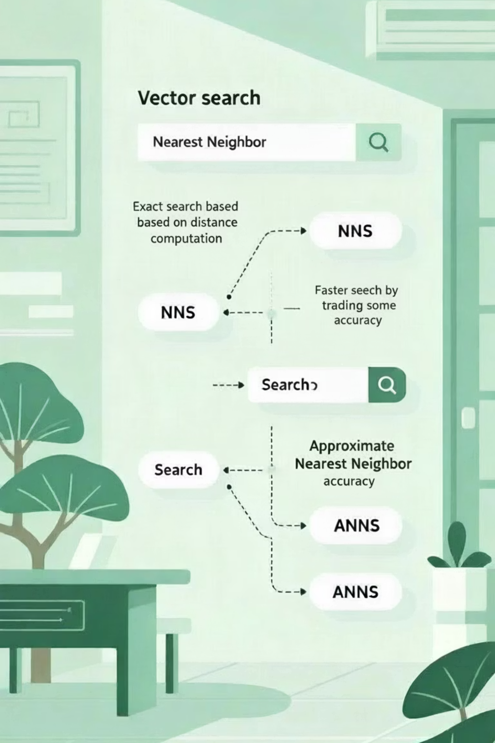
The Search Engine: Finding Needles
The true power of vector databases lies in their search functionality, primarily through Nearest Neighbor Search (NNS) and Approximate Nearest Neighbor Search (ANNS).
Nearest Neighbor Search (NNS)
Approximate Nearest Neighbor Search (ANNS)
Finds exact closest vectors. Computationally expensive but guarantees accuracy. Includes Brute Force and Tree-based algorithms (KD-Tree, Ball-Tree).
Sacrifices some accuracy for significant speed advantages. Utilizes Hash-Based, Tree-Based, Graph-Based, and Quantization-Based methods.

Slide 6

ANNS Techniques: A Deeper Dive
Hash-Based Methods
Tree-Based Techniques
Transforms high-dimensional vectors into binary codes (LSH, Spectral, Spherical, Deep Hashing).
Uses tree structures for efficient search (Annoy, Best Bin First, K-means Tree).
Graph-Based Algorithms
Quantization-Based Methods
Traces small-world networks for efficient search (NSW, HNSW).
Compresses vectors for storage and comparison (IVF, PQ, OPQ, ScaNN, IVF_PQ).

Slide 7
Challenges & Future Prospects
High Dimensional Indexing
Heterogeneous Data Types
Distributed Processing
Processing billions of high-dimensional vectors requires intensive computation.
Supporting dense, sparse, and binary vectors demands flexible indexing.
Requires sophisticated handling for partitioning, load balancing, and fault tolerance.
Integration with ML Frameworks
Security & Privacy
High-dimensional data demands robust encryption and access controls.
Needs easy-to-use APIs for TensorFlow, PyTorch, and Scikit-learn.

Slide 8




Vector Databases Enabling LLMs
Vector databases are crucial for enhancing Large Language Models (LLMs).
Retrieval-Augmented Generation (RAG)
Semantic Caching
Long-Term Memory
Reduces API calls and response time by retaining past queries and answers.
Allows LLMs to store past experiences and knowledge, enabling dynamic updates.
Acts as external knowledge, reducing hallucinations and providing context for informed responses.

Slide 9
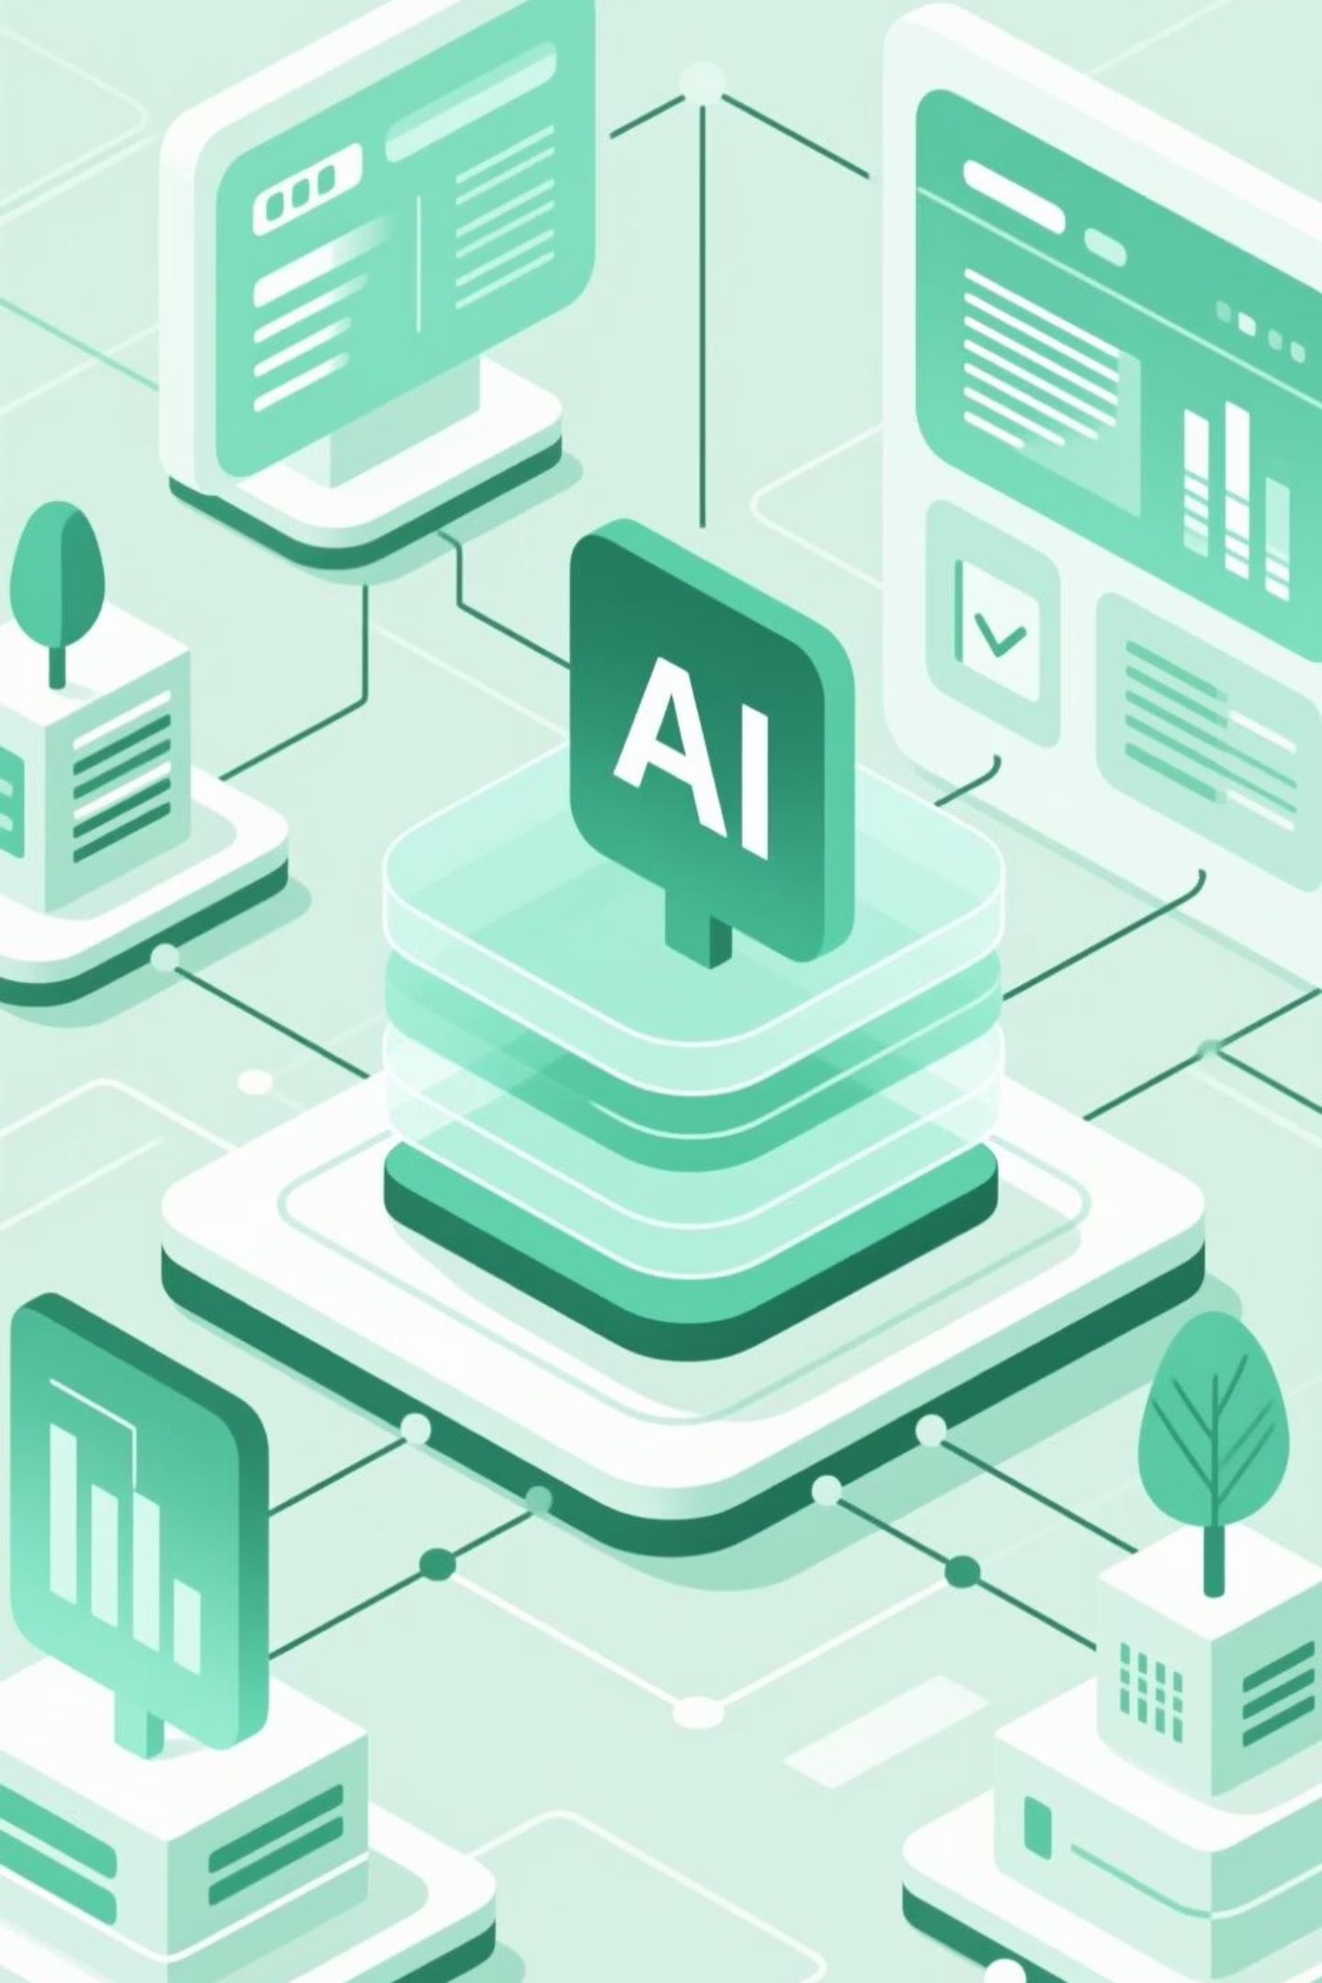
LLMs Improving Vector Databases & Unified Framework
LLMs Impact on VDBs
Unified Framework
Automated database administration and optimization.
Four levels of integration: User, System, AI Database, and Data. This enables complex applications from voice assistants to expert systems.
Natural language interfaces for search functionality.
Enhanced data management and system optimization.
Vector databases are the foundation for future intelligent systems, with their evolution promising deeper integration and advanced processing power.

